Slide 1
Linear Algebra
Chapter 1
Vector

Slide 2
Agenda
What is Vector?
Vector Representation
Vector Addition
Multiply Vector with a scalar

Slide 3
What is Vector?
A vector is an object that has both magnitude and a direction.
Geometrically, we can draw a vector as a directed line segment, whose length is the magnitude of the vector and with an arrow indicating the direction.
The direction of the vector is from its tail to its head.

Slide 4
What is Vector?
Head
Magnitude
Direction
Tail

Slide 5
Vector
Two vectors are the same if they have the same magnitude and direction.
We denote vectors using bold faces as in a or b.
We also denote vectors using arrows as in $\vec{a}$ or $\vec{b}$
We denote the magnitude (length) of the vector by $||\vec{a}||$

Slide 6
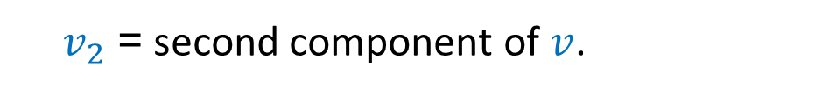
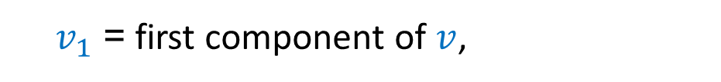
Vector
Two dimensional vector:
Column vector $v=\left[\begin{matrix}v_{1} \\ v_{2}\end{matrix}\right]$
$v_{1}$= first component of $v$,
$v_{2}$= second component of $v$.
We write $v$ as a column vector, not as a row.

Slide 7
Difference between point and vector
A point has position in space. The only characteristic that distinguishes one point from another is its position.
A vector has both magnitude and direction, but no fixed position in space.

Slide 8
Point
Point (2, 3)

Slide 9
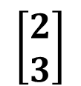
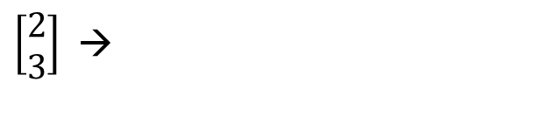
Vector Representation
$\left[\begin{matrix}2 \\ 3\end{matrix}\right]$ →
$$\left[\begin{matrix}2 \\ 3\end{matrix}\right]$$
First component: 2 units in the horizontal direction (left to right)
Second component: 3 units in the vertical direction (bottom to top)

Slide 10




Vector Representation
$$\left[\begin{matrix}2 \\ 3\end{matrix}\right]$$
$$\left[\begin{matrix}2 \\ 3\end{matrix}\right]$$
$$\left[\begin{matrix}2 \\ 3\end{matrix}\right]$$
$$\left[\begin{matrix}2 \\ 3\end{matrix}\right]$$
A vector need not start at the origin. It can be located anywhere.

Slide 11
Vector Representation
All the below vectors are same and the vector is $\left[\begin{matrix}3 \\ 0\end{matrix}\right].$

Slide 12
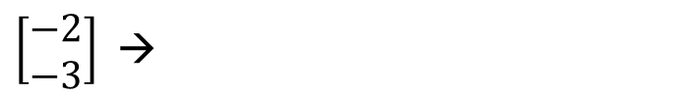
Vector Representation
All the below vectors are same and the vector is $\left[\begin{matrix}−2 \\ −3\end{matrix}\right].$
$\left[\begin{matrix}−2 \\ −3\end{matrix}\right]$ →
First component: 2 units in the horizontal direction (right to left because of –ve sign)
Second component: 3 units in the vertical direction (top to bottom because of –ve sign)

Slide 13
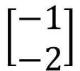
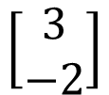


Vector Representation
$$\left[\begin{matrix}2 \\ 3\end{matrix}\right]$$
$$\left[\begin{matrix}1 \\ 2\end{matrix}\right]$$
$$\left[\begin{matrix}−1 \\ −2\end{matrix}\right]$$
$$\left[\begin{matrix}3 \\ −2\end{matrix}\right]$$

Slide 14
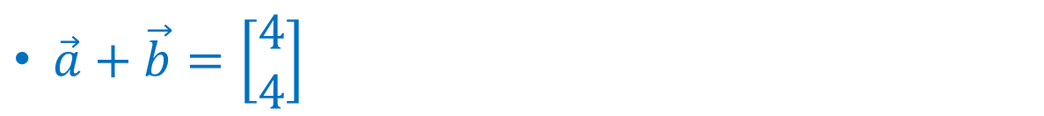
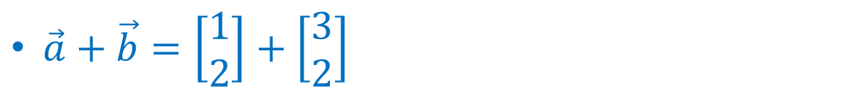
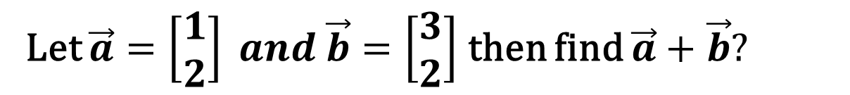
Vector Operations
Vector Addition
Let $\vec{a}=\left[\begin{matrix}1 \\ 2\end{matrix}\right] and \vec{b}=\left[\begin{matrix}3 \\ 2\end{matrix}\right]$ then find $\vec{a}+$ $\vec{b}?$
$\vec{a}+\vec{b}=\left[\begin{matrix}1 \\ 2\end{matrix}\right]+\left[\begin{matrix}3 \\ 2\end{matrix}\right]$
$\vec{a}+\vec{b}=\left[\begin{matrix}4 \\ 4\end{matrix}\right]$

Slide 15
Vector Addition–Geometrical View
Let $\vec{a}=\left[\begin{matrix}1 \\ 2\end{matrix}\right] and \vec{b}=\left[\begin{matrix}3 \\ 2\end{matrix}\right]$ then find $\vec{a}+$ $\vec{b}?$
Geometrically the sum of two vectors is obtained as follows:
Place the tail of $\vec{b}$ at the head of $\vec{a}$ or
Place the tail of $\vec{a}$at the head $\vec{b}.$

Slide 16
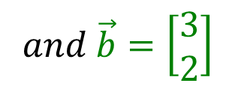
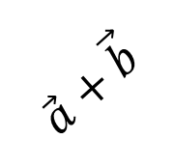


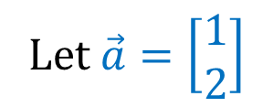
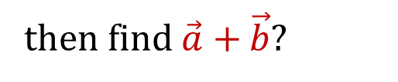
Vector Addition–Geometrical View
Let $\vec{a}=\left[\begin{matrix}1 \\ 2\end{matrix}\right]$
$$and \vec{b}=\left[\begin{matrix}3 \\ 2\end{matrix}\right]$$
$$\vec{a}+\vec{b}$$
$$\vec{a}$$
then find $\vec{a}+$ $\vec{b}?$
$$\vec{b}$$

Slide 17
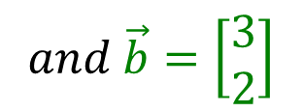
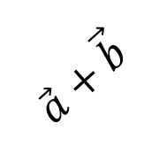


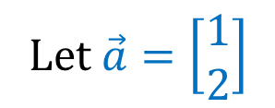
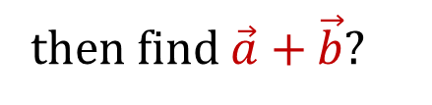
Vector Addition–Geometrical View
Let $\vec{a}=\left[\begin{matrix}1 \\ 2\end{matrix}\right]$
$and \vec{b}=\left[\begin{matrix}3 \\ 2\end{matrix}\right]$
$$\vec{b}$$
$$\vec{a}$$
$$\vec{a}+\vec{b}$$
then find $\vec{a}+$ $\vec{b}?$

Slide 18
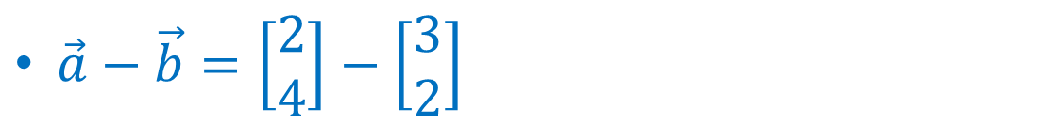
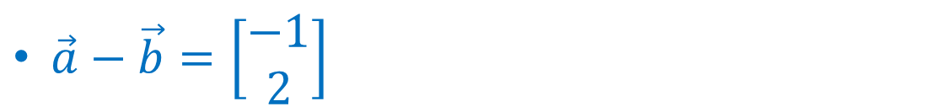
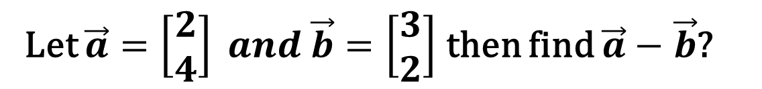
Vector Subtraction
Let $\vec{a}=\left[\begin{matrix}2 \\ 4\end{matrix}\right] and \vec{b}=\left[\begin{matrix}3 \\ 2\end{matrix}\right]$ then find $\vec{a}−$ $\vec{b}$?
$\vec{a}−\vec{b}=\left[\begin{matrix}2 \\ 4\end{matrix}\right]−\left[\begin{matrix}3 \\ 2\end{matrix}\right]$
$\vec{a}−\vec{b}=\left[\begin{matrix}−1 \\ 2\end{matrix}\right]$

Slide 19
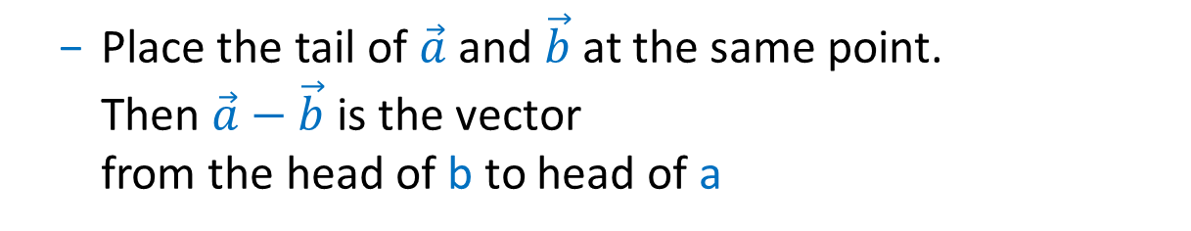
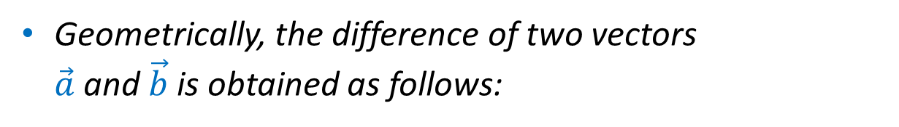
Vector Subtraction–Geometrical view
Geometrically, the difference of two vectors $\vec{a}$ and $\vec{b}$ is obtained as follows:
Place the tail of $\vec{a}$ and $\vec{b}$ at the same point. Then $\vec{a}−$ $\vec{b}$ is the vector from the head of b to head of a
Reason: If we add $\vec{a}−$ $\vec{b}$ to $\vec{b}$, we get $\vec{a}$

Slide 20
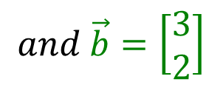



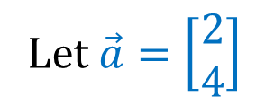
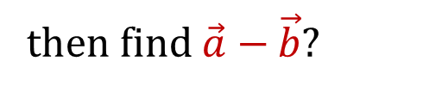
Vector Subtraction–Geometrical view
Let $\vec{a}=\left[\begin{matrix}2 \\ 4\end{matrix}\right]$
$$and \vec{b}=\left[\begin{matrix}3 \\ 2\end{matrix}\right]$$
$$\vec{a}−\vec{b}$$
$$\vec{a}$$
then find $\vec{a}−$ $\vec{b}$?
$$\vec{b}$$

Slide 21
Multiply vector with scalar
We can multiply a vector with a real number c.
Let $\vec{a}=\left[\begin{matrix}1 \\ 2\end{matrix}\right]$then find c$\vec{a}$?
$c\vec{a}=c\left[\begin{matrix}1 \\ 2\end{matrix}\right]$
$c\vec{a}=\left[\begin{matrix}c \\ 2c\end{matrix}\right]$
Here c is a scalar (any real number)

Slide 22
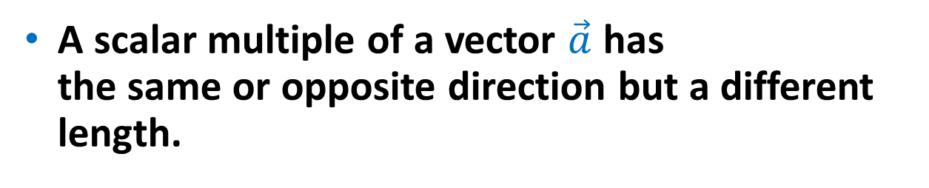
Multiply vector with scalar
A scalar multiple of a vector $\vec{a}$ has the same or opposite direction but a different length.

Slide 23
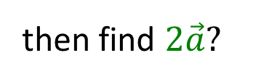


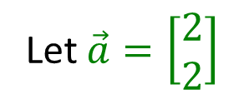
Multiply vector with scalar
$$\vec{2a}$$
Let $\vec{a}=\left[\begin{matrix}2 \\ 2\end{matrix}\right]$
then find $2\vec{a}$?
$$\vec{a}$$

Slide 24
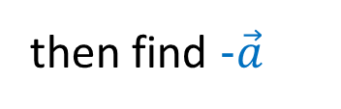



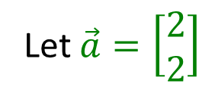
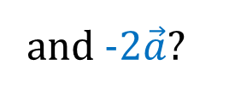
Multiply vector with scalar
Let $\vec{a}=\left[\begin{matrix}2 \\ 2\end{matrix}\right]$
then find -$\vec{a}$
$$\vec{a}$$
and -2$\vec{a}$?
$$−\vec{a}$$
$$−2\vec{a}$$

Slide 25
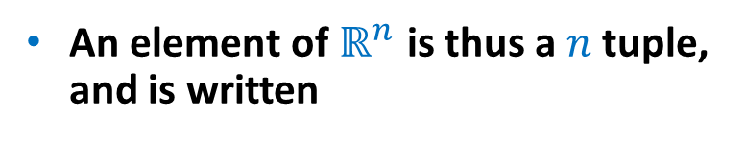


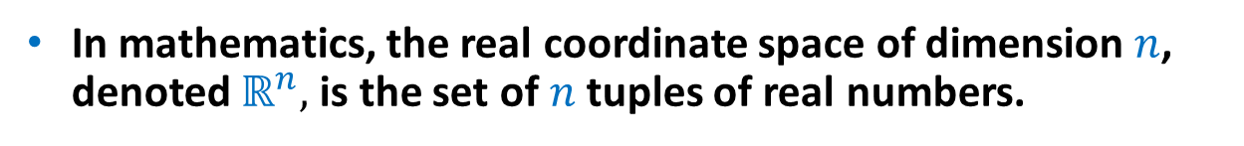
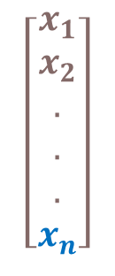
Real coordinate space
In mathematics, the real coordinate space of dimension $n$, denoted $ℝ^{n},$ is the set of $n$tuples of real numbers.
For any natural number $n$, the set $ℝ^{n}$ consists of all $n$-tuples of real numbers ($ℝ$).
It is called the "n-dimensional real space” or the "real n-space".
$$\left[\begin{aligned}x_{1} \\ x_{2} \\ . \\ . \\ . \\ x_{n}\end{aligned}\right]$$
An element of $ℝ^{n}$ is thus a $n$ tuple, and is written
Where each $x_{i}$ is a real number.

Slide 26

Real coordinate space
$ℝ^{2} −$ Two dimensional real valued tuples
$ℝ^{3} −$ Three dimensional real valued tuples
Let $\vec{a}=\left[\begin{matrix}1 \\ 2\end{matrix}\right]$ and $\vec{b}=\left[\begin{matrix}3 \\ 4\end{matrix}\right]$. In this case $\vec{a}∈ℝ^{2} and \vec{b}∈ℝ^{2}$
Let $\vec{u}=\left[\begin{matrix}1 \\ \begin{aligned}2 \\ 3\end{aligned}\end{matrix}\right]$ and $\vec{v}=\left[\begin{matrix}3 \\ \begin{aligned}4 \\ 5\end{aligned}\end{matrix}\right]$. In this case $\vec{u}∈ℝ^{3} and \vec{v}∈ℝ^{3}$

Slide 27
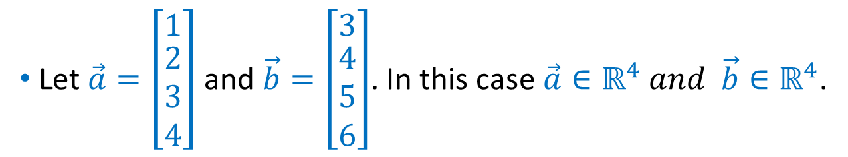

Addition of two vectors in $ℝ^{4}$
$ℝ^{4} −$ Four dimensional real valued tuples
Let $\vec{a}=\left[\begin{matrix}1 \\ \begin{aligned}2 \\ 3 \\ 4\end{aligned}\end{matrix}\right]$ and $\vec{b}=\left[\begin{matrix}3 \\ \begin{aligned}4 \\ 5 \\ 6\end{aligned}\end{matrix}\right]$. In this case $\vec{a}∈ℝ^{4} and \vec{b}∈ℝ^{4}$.

Slide 28
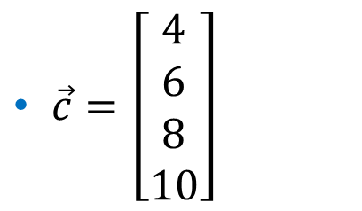
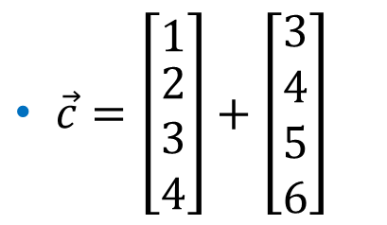
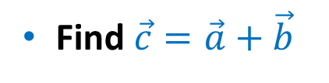
Addition of two vectors in $ℝ^{4}$
Find $\vec{c}=\vec{a}+\vec{b}$
$\vec{c}=\left[\begin{matrix}1 \\ \begin{aligned}2 \\ 3 \\ 4\end{aligned}\end{matrix}\right]+\left[\begin{aligned}3 \\ 4 \\ 5 \\ 6\end{aligned}\right]$
$\vec{c}=\left[\begin{aligned}4 \\ 6 \\ 8 \\ 10\end{aligned}\right]$

Slide 29
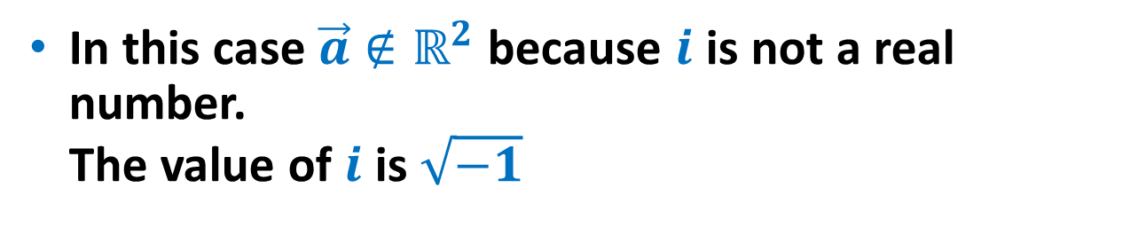

Example
Let $\vec{a}=\left[\begin{aligned}i \\ 2\end{aligned}\right]$.
In this case $\vec{a}∉ℝ^{2}$ because $i$ is not a real number. The value of $i$ is $\sqrt{−1}$

Slide 30

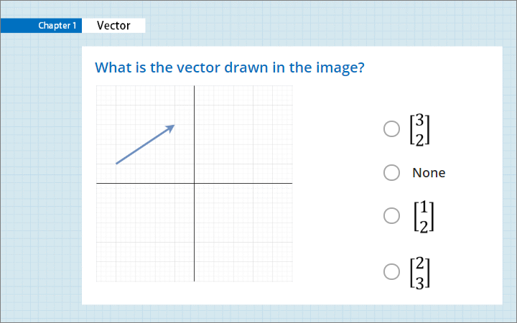
Quiz
Click the Quiz button to edit this object

Slide 31
Summary
Vector
Vector Representation
Vector Addition
Vector multiplication by a scalar

